Slide 1
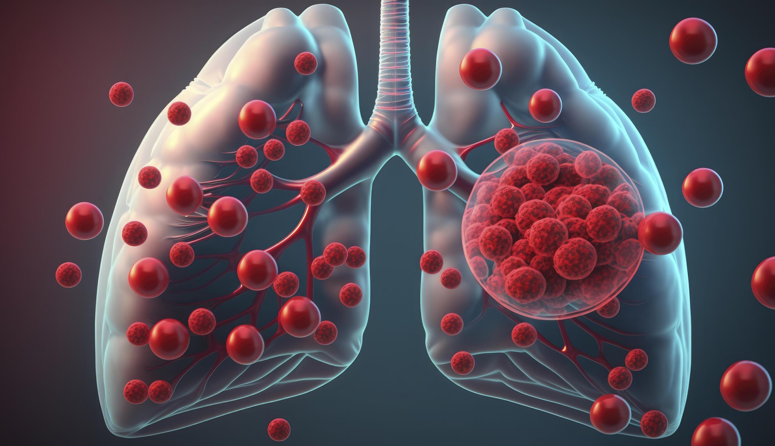

INTEGRATIVE MACHINE LEARNING APPROACH FOR FORECASTING LUNG CANCER
CHEMOSENSITIVITY
Sudarshan – 25064
Sathvik – 25057
Vivek – 25063
Naren - 25034

Slide 2
Problem Statement : -
The chemotherapy response will be different for each person
A significant number of patients with Extensive-Stage Small Cell Lung Cancer (ES-SCLC) initially respond well to chemotherapy, but their tumors quickly become resistant, leading to recurrence and death.
Develop a robust and accurate machine learning model capable of predicting the chemosensitivity of lung cancer patients.

Slide 3
Objective : -
Taking a pre-processed dataset from G.E.O (gene expression omnibus) .
Train 3 Machine Learning model’s :
(i) Hybrid model [R.F. + S.V.M]
(ii) Gradient Boosting Machine[G.B.M]
(iii) LASSO [Least Absolute Shrinkage and Selection Operator ]
3)Compare these ML model’s based on the accuracy and precision graph.

Slide 4
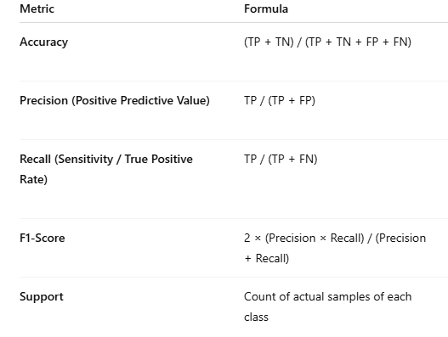
Introduction : -
The Challenge of Resolution: Extensive-Stage Small Cell Lung Cancer (ES-SCLC) is characterized by rapid development of acquired chemo-resistance, which current bulk-level genomic analysis fails to accurately predict.
Leveraging Data: Our approach tackles this complexity by utilizing data. This provides transcriptomic resolution at the individual cell level, allowing us to identify distinct, rare cell subpopulations that drive the differential chemotherapy response
The Machine Learning Objective: The core challenge is extracting a minimal, robust, and predictive gene signature from this high-dimensional single-cell dataset.
Model Implementation: We employ the hybrid model [R.F. + S.V.M] , LASSO , G.B.M (Gradient Boosting Machine )The objective of the model is to:
To compare and find the best model for the chemosensitivity predictions.
Develop a parsimonious prognostic signature that accurately classifies patients into response categories (PR or PD) based on the gene expression profile of the critical cell subtypes identified via scRNA-seq clustering.
Meaning :
True Positive : Model correctly predicts disease present
True Negative : Model correctly predicts no disease
False Positive : Model predicts disease, but person is healthy
False Negative : Model predicts no disease, but person actually has disease.

Slide 5
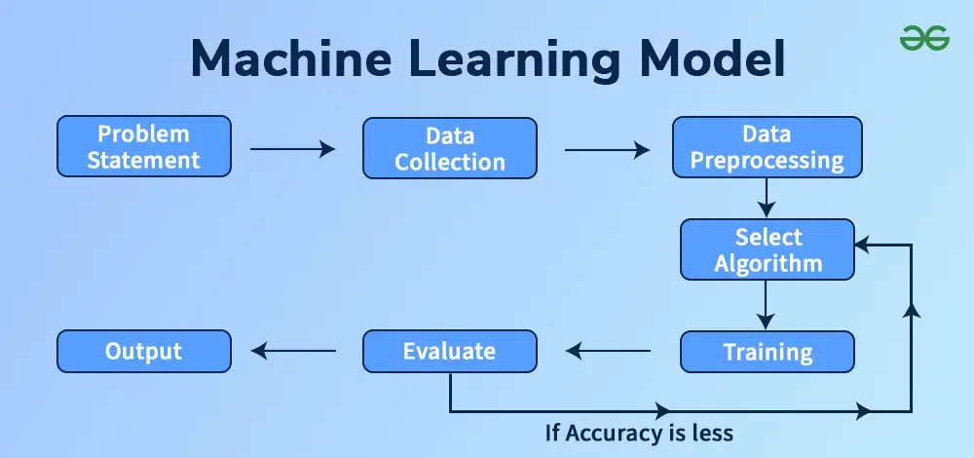

Things We Are Going To Consider To Decide The Final Model : -
Meaning :
True Positive : Model correctly predicts disease present
True Negative : Model correctly predicts no disease
False Positive : Model predicts disease, but person is healthy
False Negative : Model predicts no disease, but person actually has disease.

Slide 6
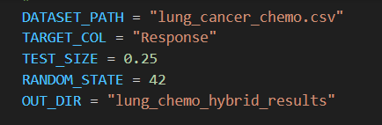
Methodology : -
Hybrid model , Lasoo and G.B.M. we have a downloaded a C.S.V file
As they are already pre-processed dataset , we are using it directly
Then we train them , test them , validate them
Feature extraction , we get the confusion graphs , accuracy comparison graphs
By comparing the overall accuracy, we decide the final ML to be used in the research process .

Slide 7
DATASET : -
The data set is the csv file, it is synthetic data .
that contains the information related to the patients with lung cancer.
we directly used the “.read” , command for the deploying the ML models .
We used the same dataset for the three models , for training, testing , validation.

Slide 8
Hybrid model function explanation : -
This is basically combination of the 2 most powerful ML models i.e. random forest and svm .
Work of random forest : - It combines the results of many individual Decision Trees to make a final, more accurate, and stable prediction.
Work of S.V.M : - For classification, it finds the best hyperplane that maximally separates data points belonging to different classes in a high-dimensional space.
It learns the optimal weighting and combination strategy for the base models. It essentially learns when to trust the R.F. score and when to trust the S.V.M. score.
The combined work of the these models : -
R.F. makes a prediction by having many models (trees) vote. We could say it's the model that uses collective intelligence to decide on the outcome
S.V.M. makes a prediction by finding the optimal boundary that best separates the data points

Slide 9
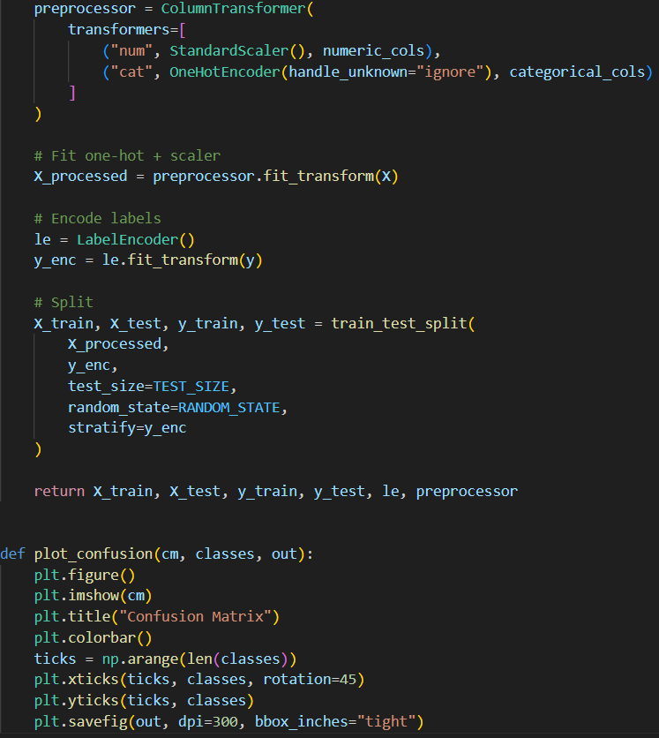
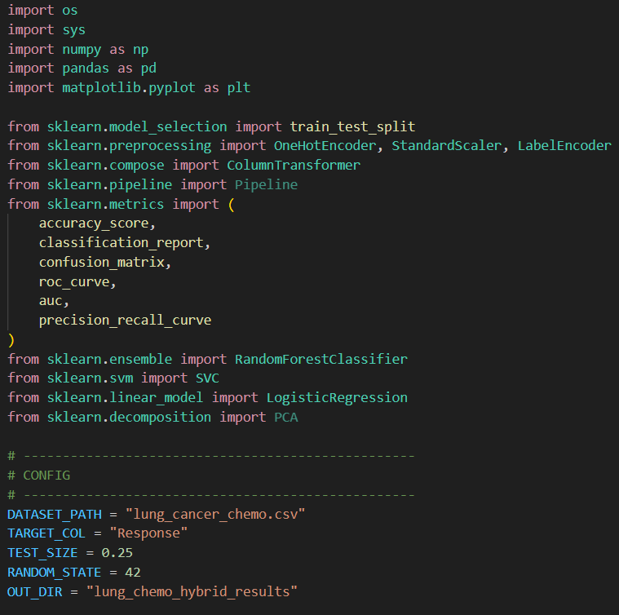
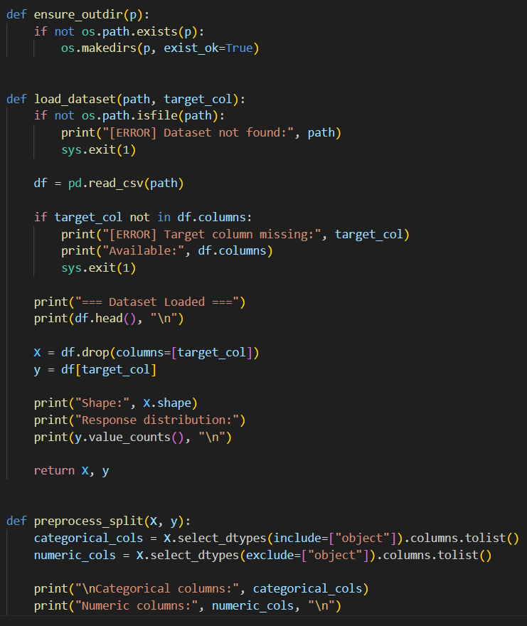
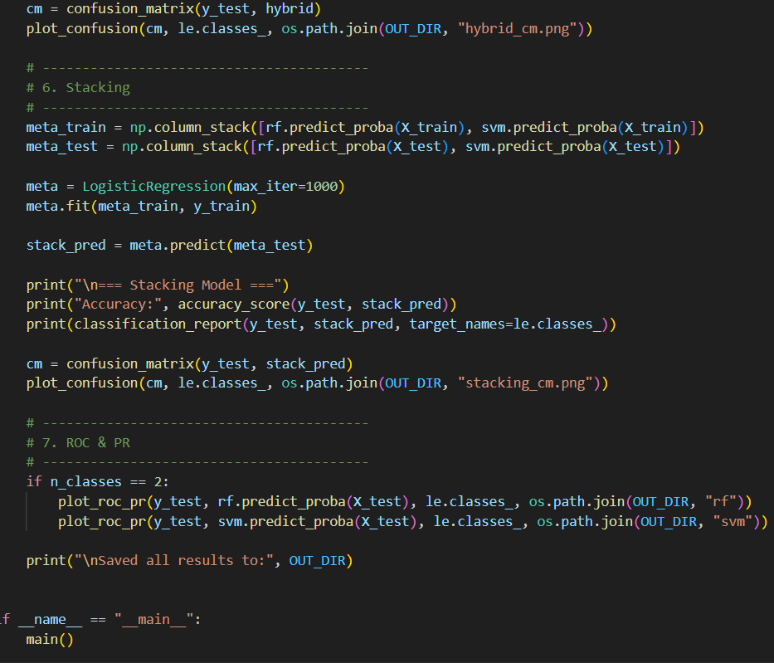
1.Hybrid model [R.F. + S.V.M ] : -
The code for the hybrid model , that will generate the output including the graphs .

Slide 10
THE FEATURES/graphs OF THE HYBRID MODEL :-
For the output , we got 6 graphs were generated
3 confusion matrices , 2 AUC graphs , 1 ROC graph
The 2 confusion matrix are of stacking and S.V.M
AS the accuracy is 100% , we got straight lines in AUC graphs.

Slide 11
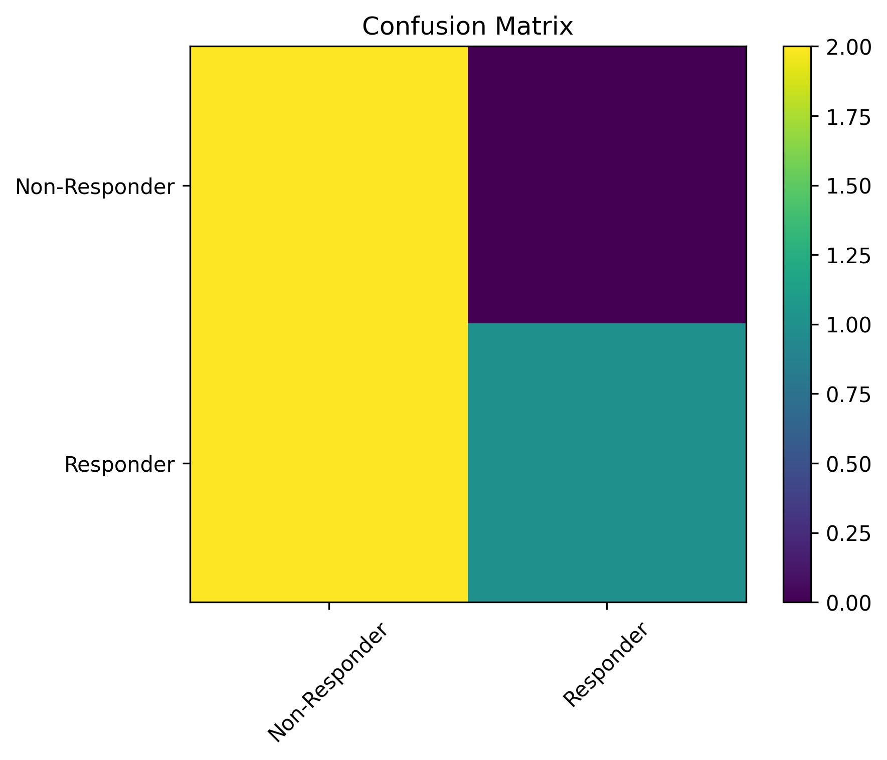
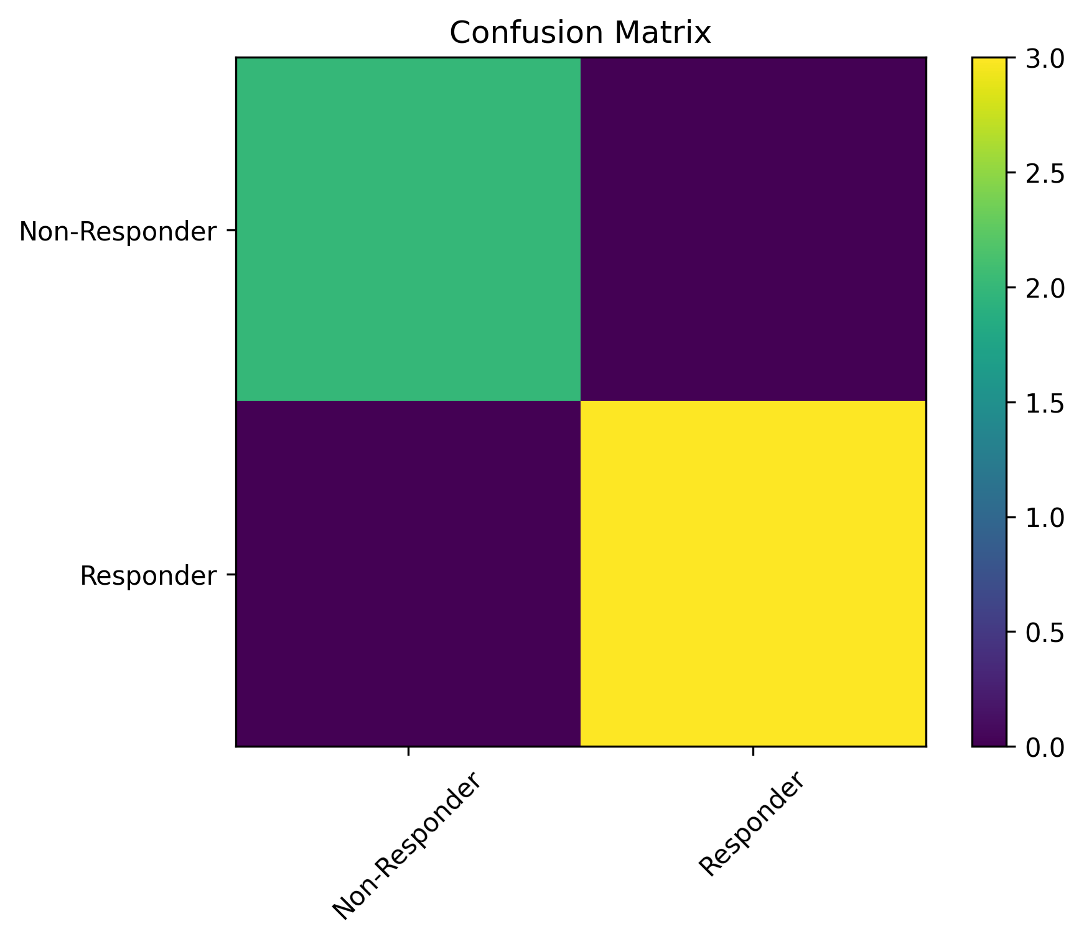
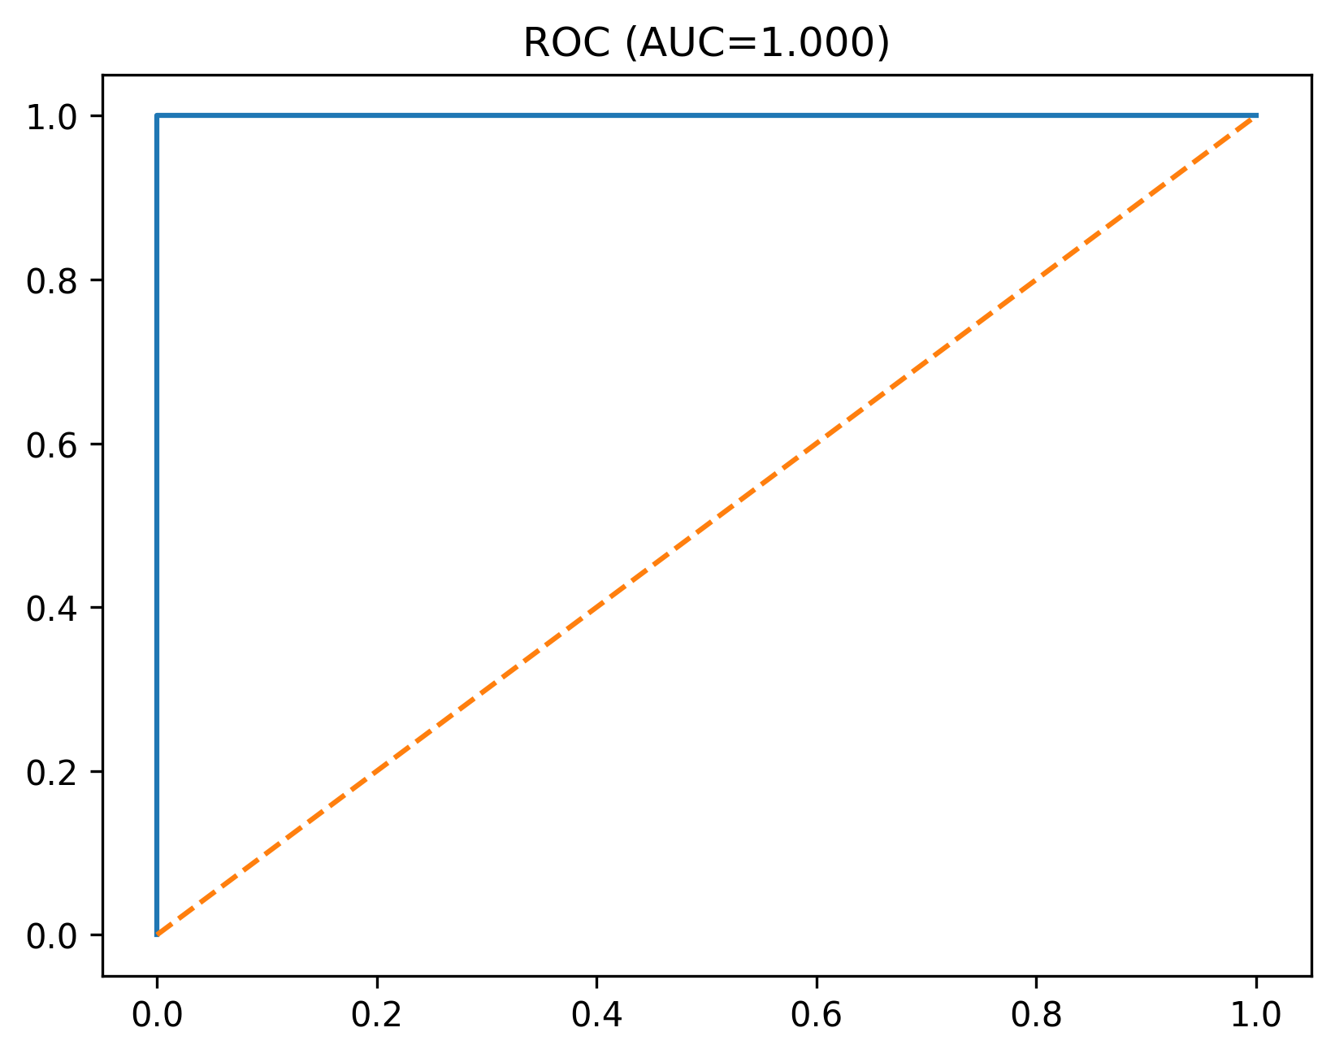
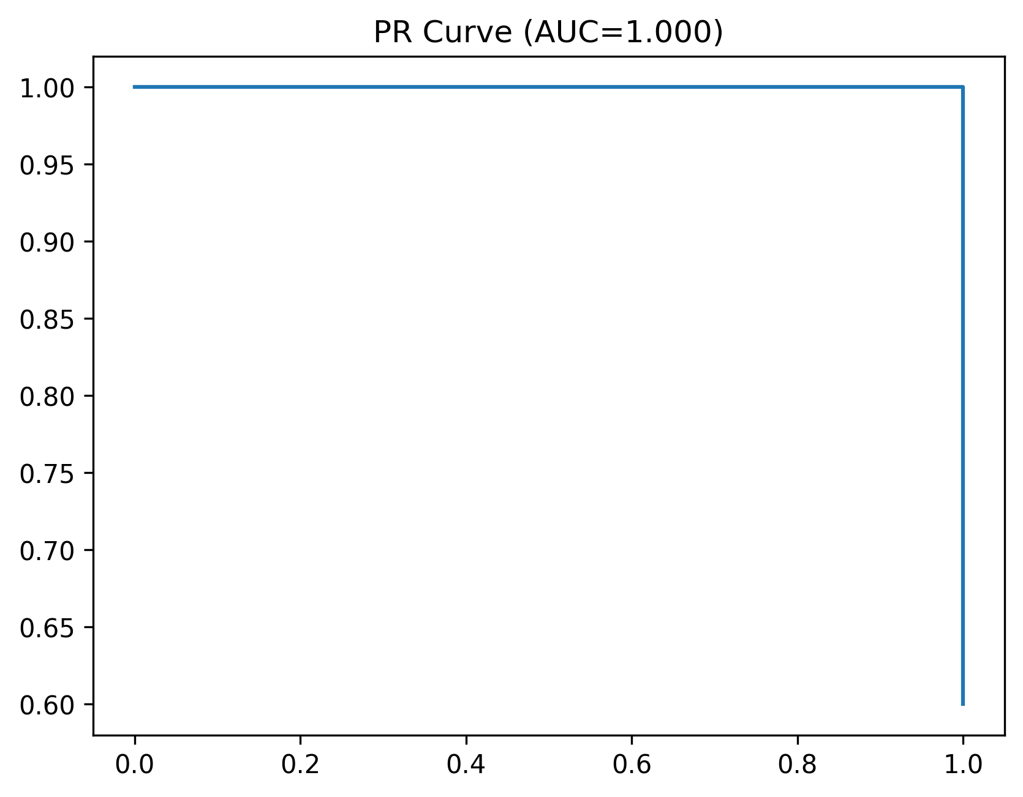
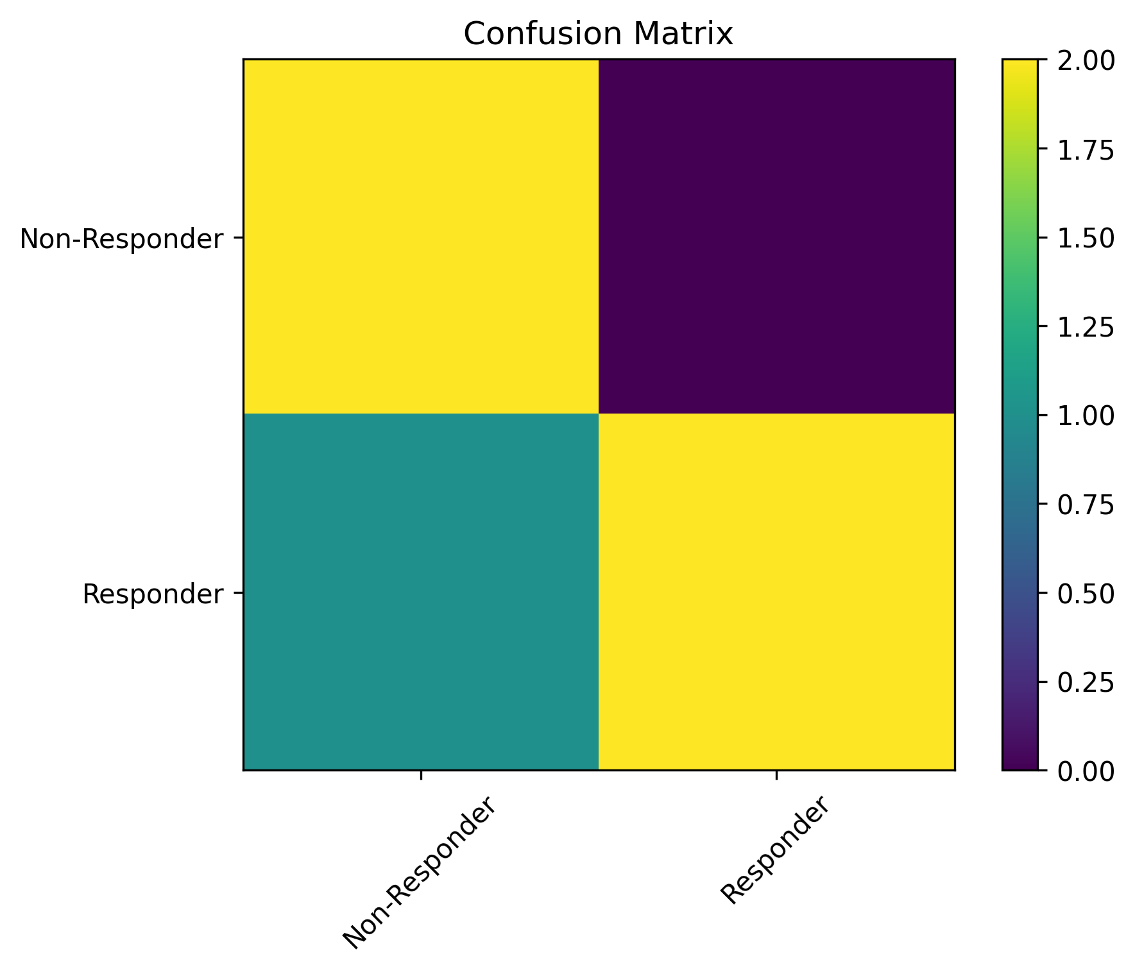
Hybrid model confusion matrix
S.V.M confusion matrix
stacking confusion matrix
Random forest confusion matrix

Slide 12
Area under the curve graph and ROC graph of S.V.M : -

Slide 13
Area under the curve graph and ROC graph of R.F. : -

Slide 14
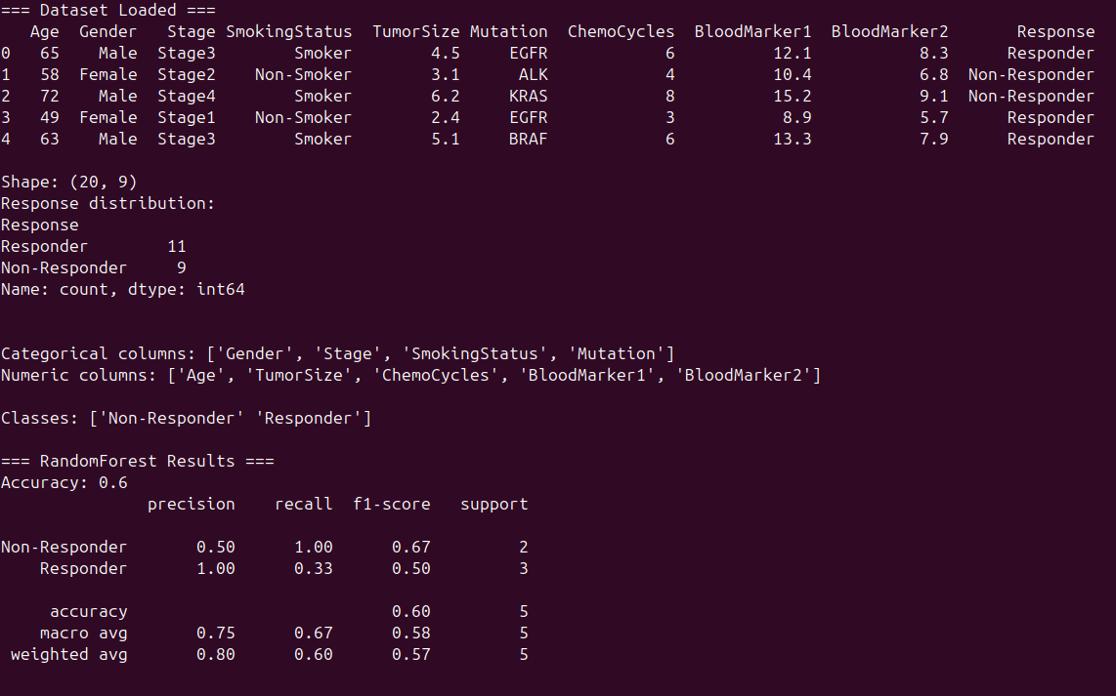
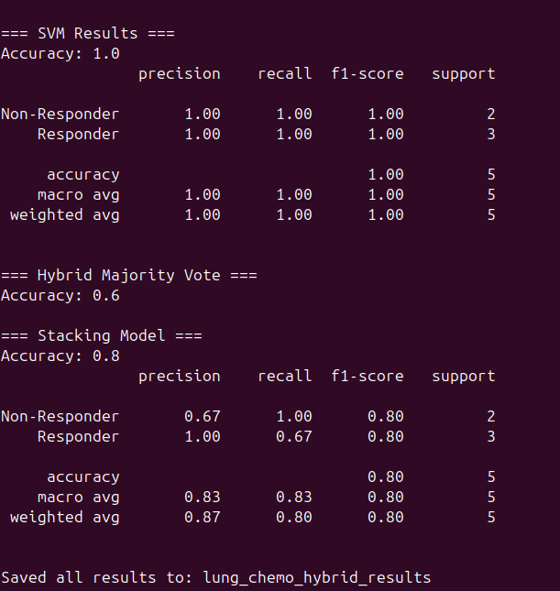
The implementation/accuracy/f1-score/precision of hybrid model : -

Slide 15
LASSO model function explanation :-
LASSO (Least Absolute Shrinkage and Selection Operator)
LASSO is a type of Linear Regression model that incorporates a regularization penalty.
What it does: It fits a linear model to the data while simultaneously shrinking the model's coefficients and automatically selecting the most important features.
How it works (The Core Idea):
  It minimizes the standard sum of squared errors (the loss function).
  It adds a penalty term based on the absolute value of the size of the coefficients (this is known as L1 Regularization).
  This L1 penalty forces the coefficients of less important features to become exactly zero, effectively removing them from the model.
Key Advantage: It performs both regularization (preventing overfitting) and feature selection at the same time, resulting in a simpler, more robust, and highly interpretable model.

Slide 16
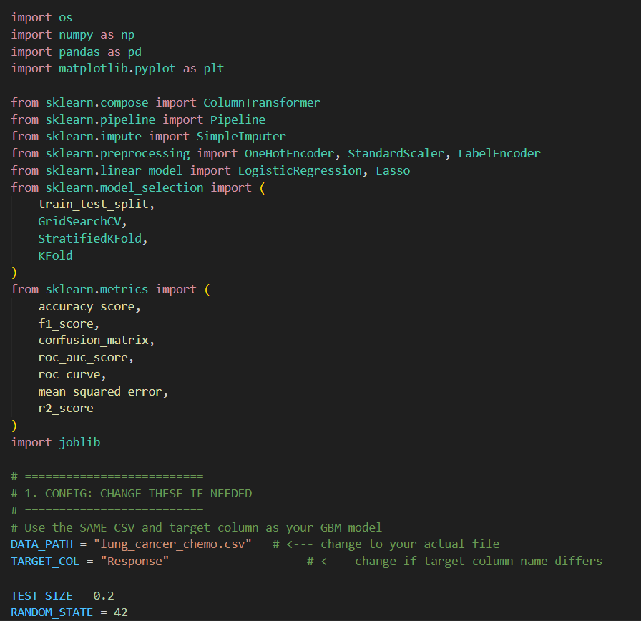
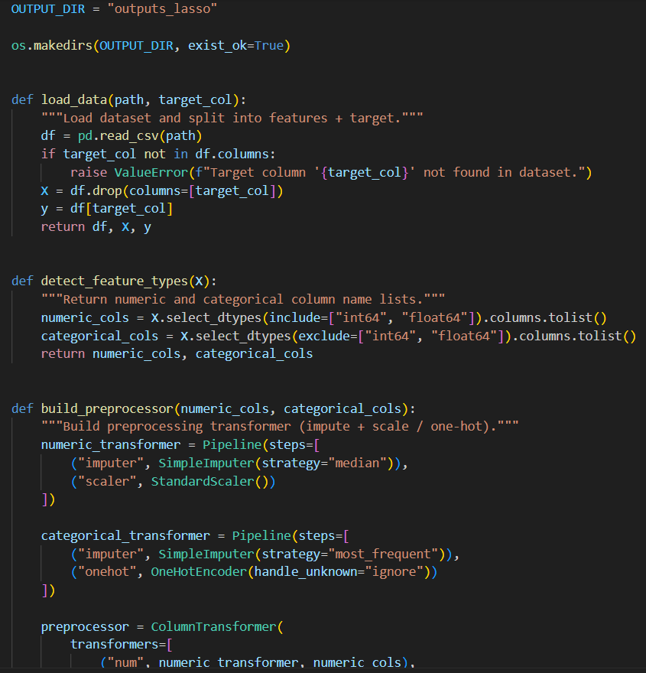
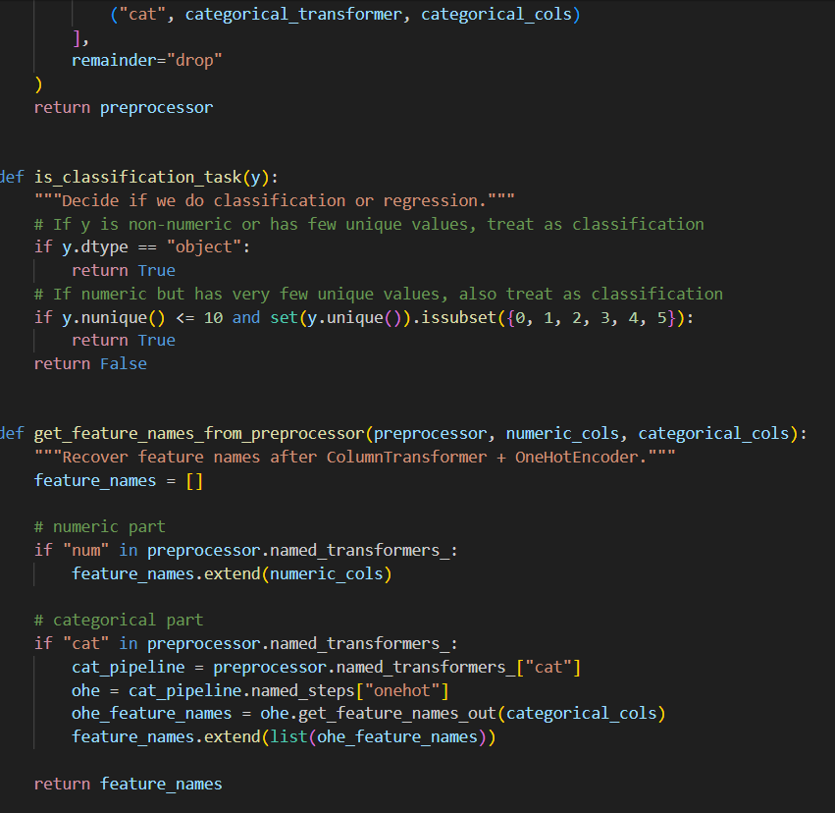
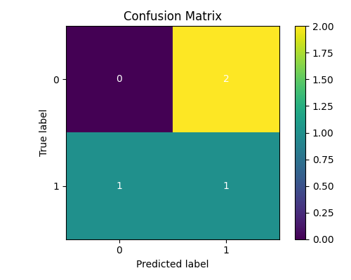
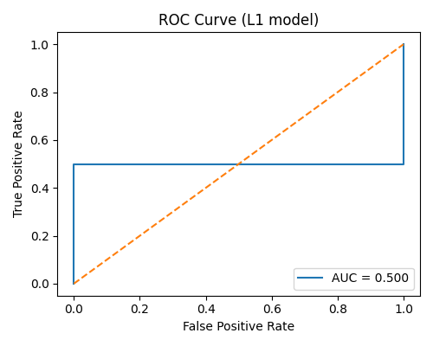
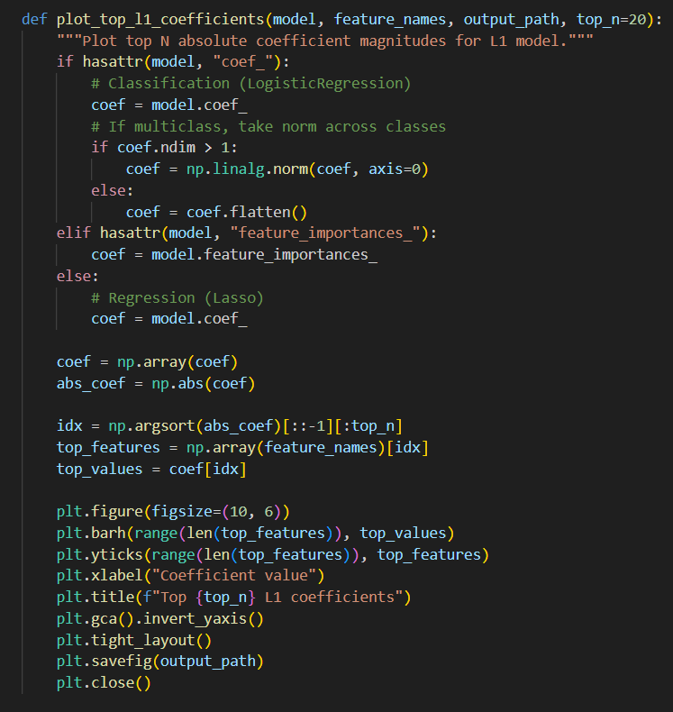
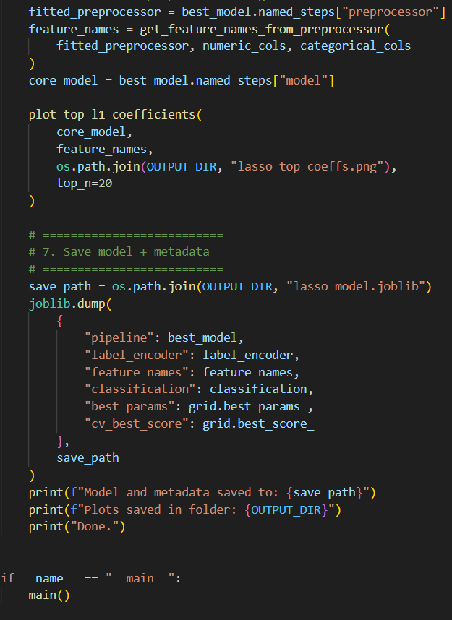
LASSO [Least Absolute Shrinkage and Selection Operator ] MODEL : -

Slide 17
THE FEATURES/graphs OF THE LASSO MODEL :-

Slide 18
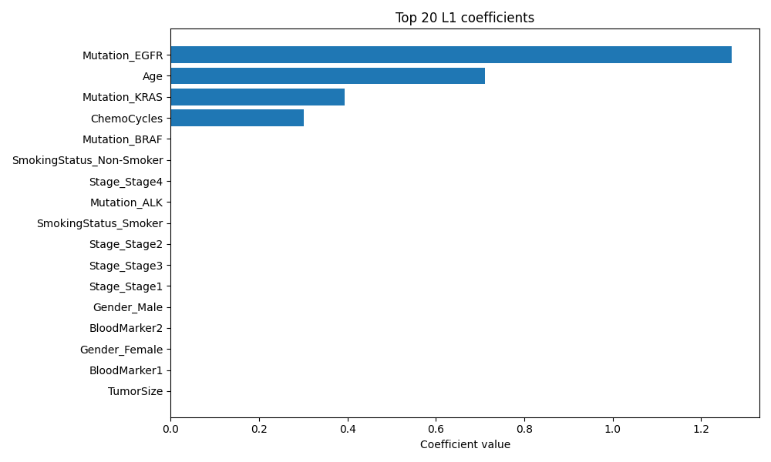
This is the bar graph done by LASSO model :-

Slide 19
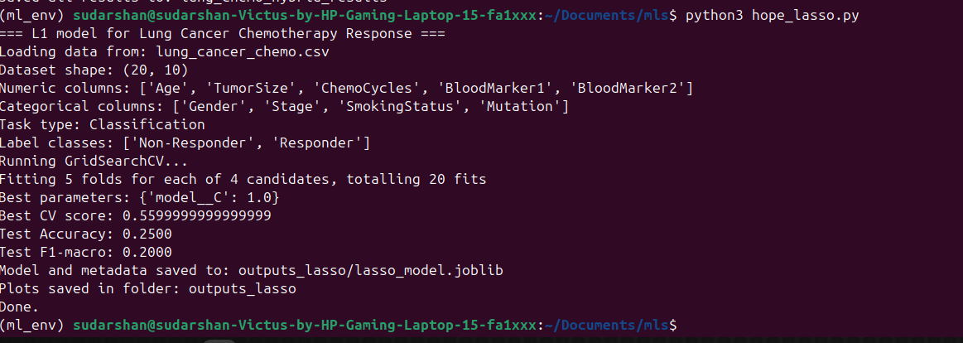
The implementation/accuracy/f1-score/precision of LASSO model : -

Slide 20
G.B.M. function explanation : -
What it does: It builds a final, highly accurate prediction model by sequentially combining the predictions of many simple, weak learner models
How it works (The Core Idea):
It starts with a simple initial prediction (e.g., the average value of the target).
Each subsequent new tree is trained not on the original data, but on the The model learns iteratively, with each new tree correcting the previous tree's weaknesses.
The final prediction is the sum of the predictions from all the sequential trees.
Key Advantage: It focuses aggressively on the hardest-to-predict data points and typically yields one of the highest predictive accuracies across a wide range of tasks, particularly when training data is abundant.

Slide 21
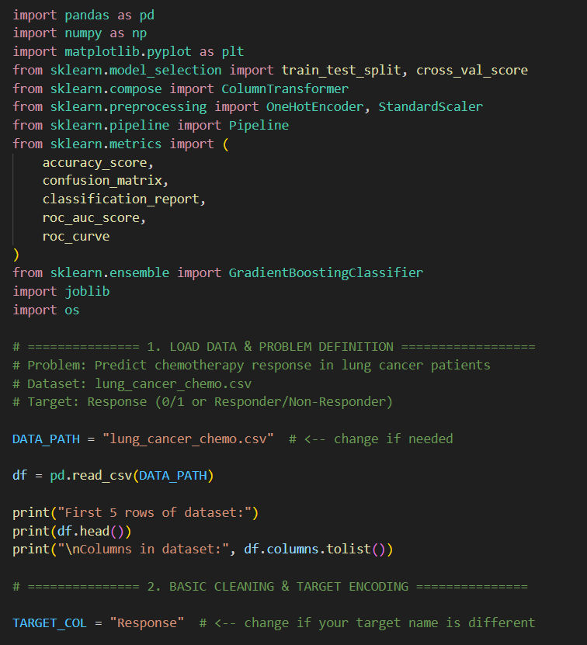
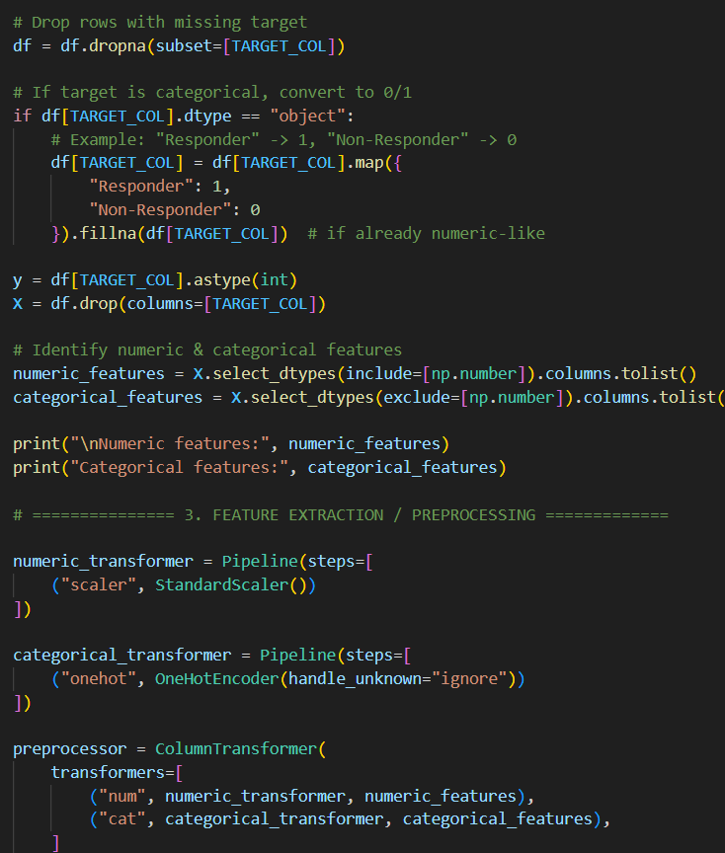
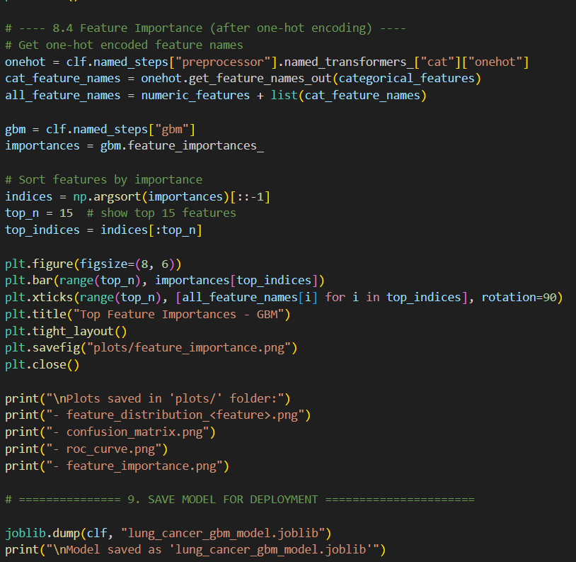
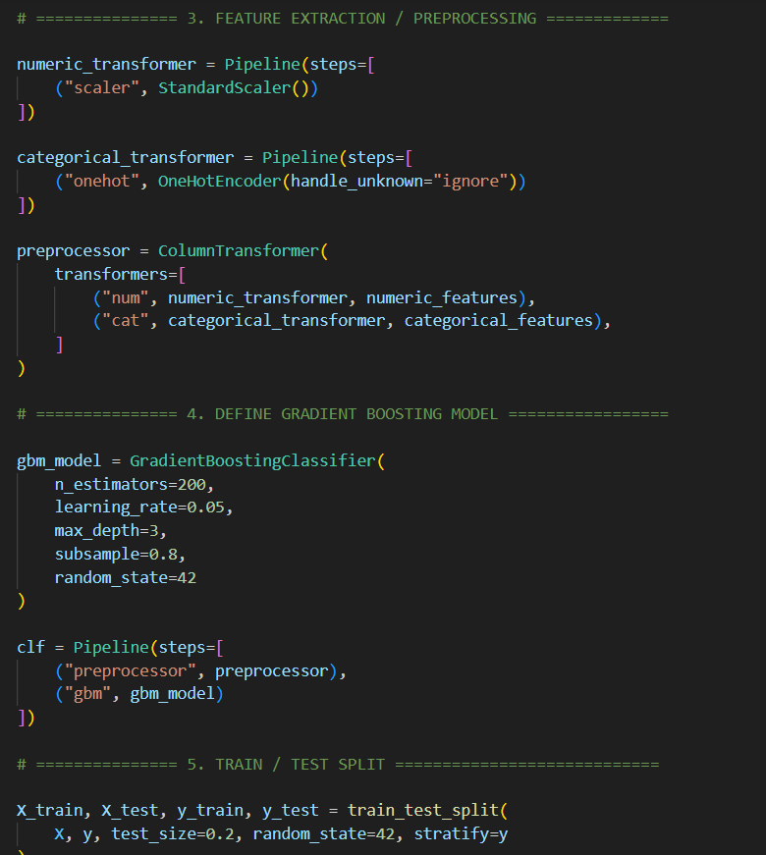
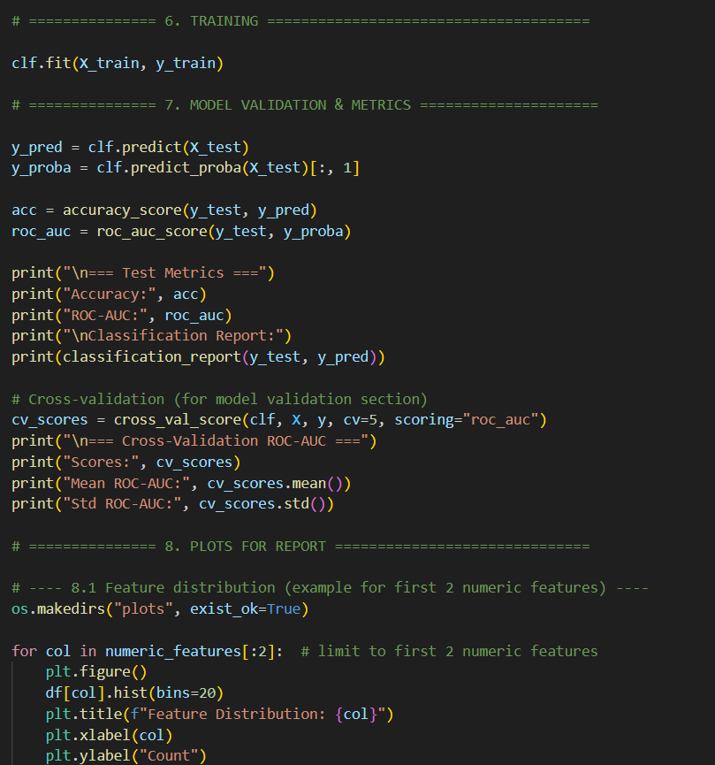
G.B.M [Gradient Boosting Machine] model :-

Slide 22
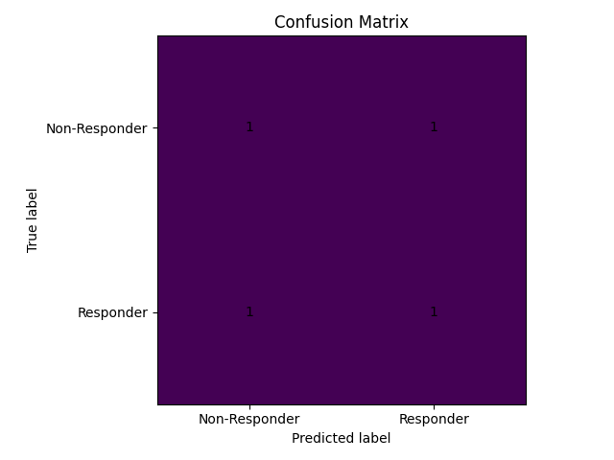
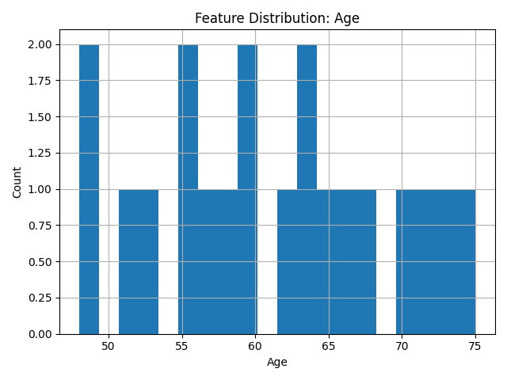
THE FEATURES/graphs OF THE G.B.M MODEL :-

Slide 23
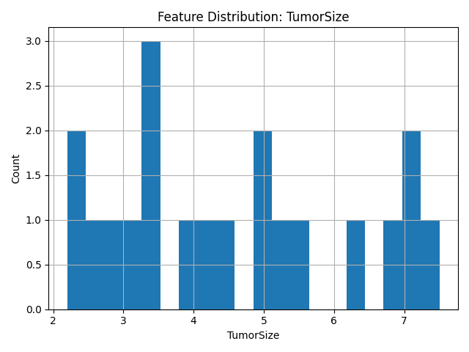
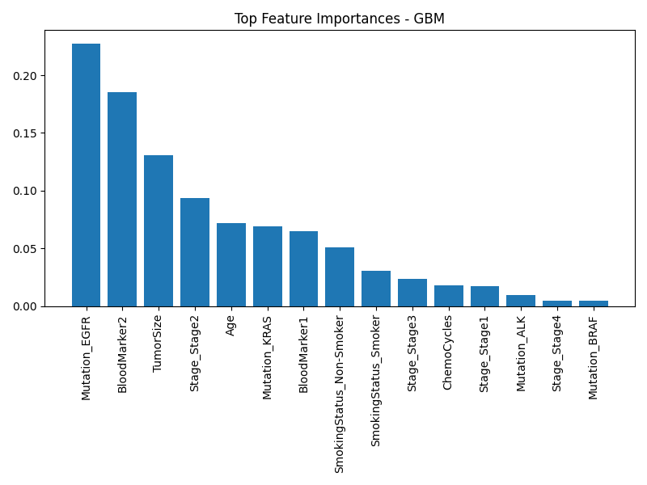

Slide 24
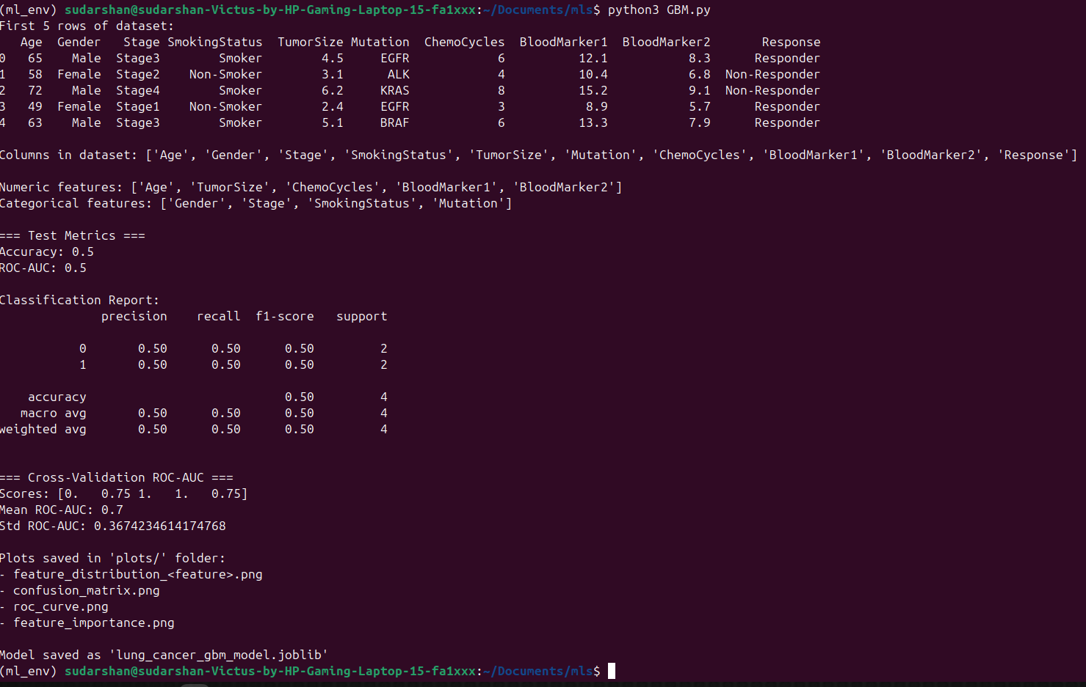
The implementation/accuracy/f1-score/precision of G.B.M model : -

Slide 25
------Thank you------
By
1.sudarshan
2.Sathvik
3.Vivek
4.naren

